Slide 1
Dynamic color
Sohaib Ahmed (Tech Lead)

Slide 2
Introduction
Beginning with Android 12, users can generate individualized schemes through wallpaper selection and other customization settings.

Slide 3
How it works?
System picks one color from the wallpaper.
It uses that color to make five tonal palettes.
Palette colors are assigned to different parts of the UI.
Custom colors (like error colors) are assigned to different parts of the UI.

Slide 4
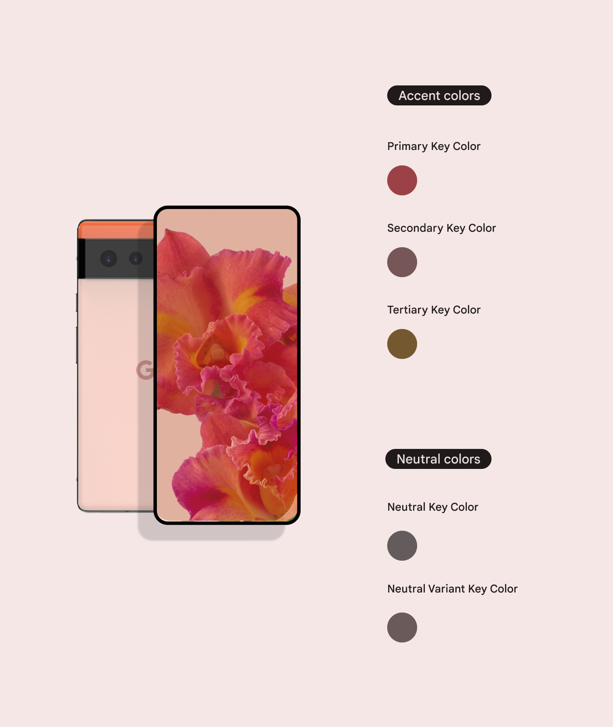

Slide 5
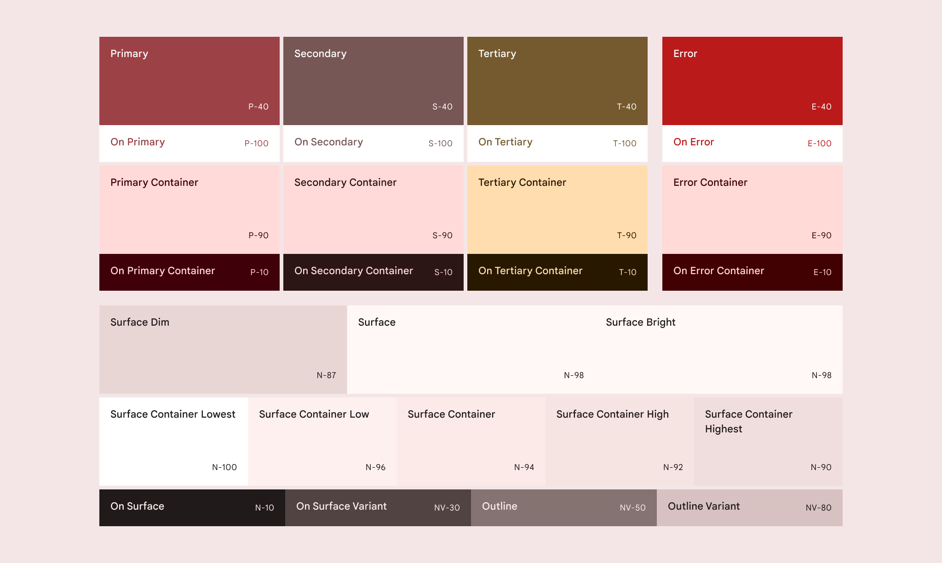

Slide 6
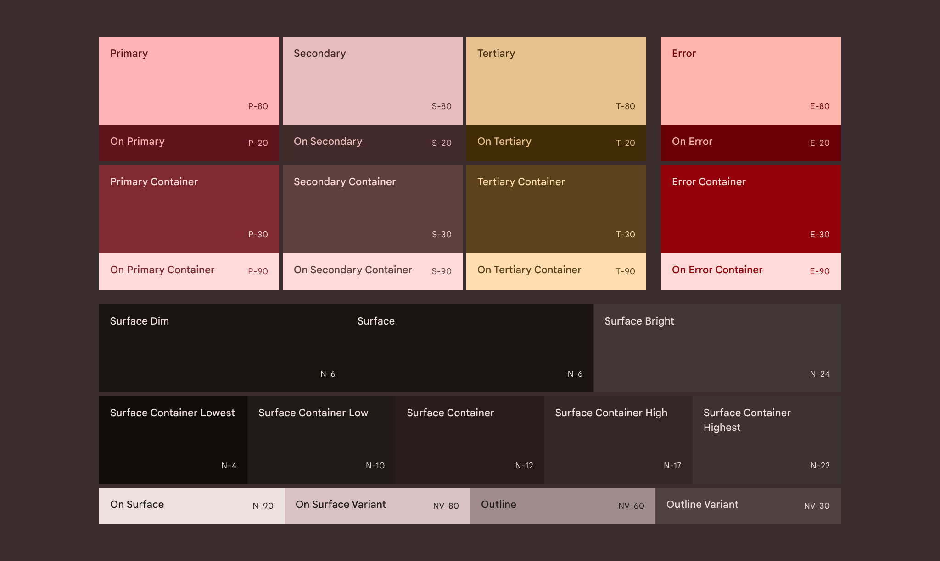

Slide 7
Color from content
In-app content colors can be derived from a range of sources, such as album artwork, a brand logo, or a video tile.

Slide 8
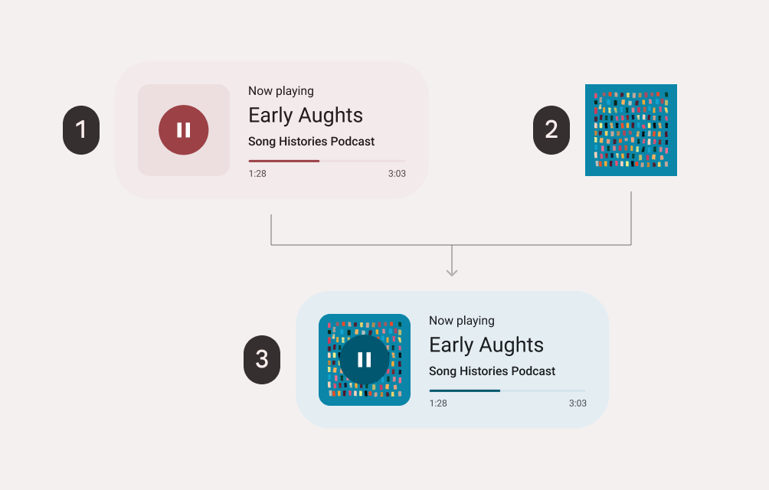
Why use content-based color?
Colors derived from local content can enhance a person’s visual and emotional connection to their experience.
In keeping with the M3 spirit, experiences can be personalized with local color derived from an individual’s in-app content preferences.

Slide 9
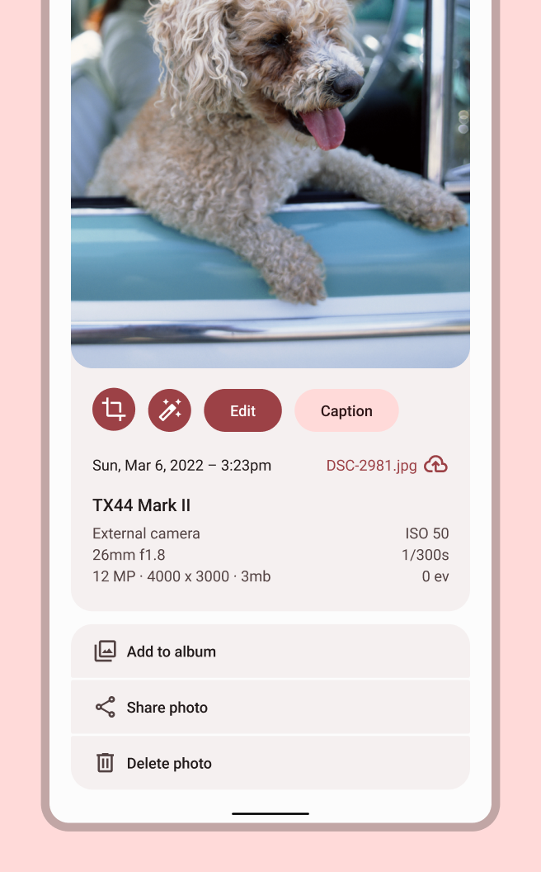
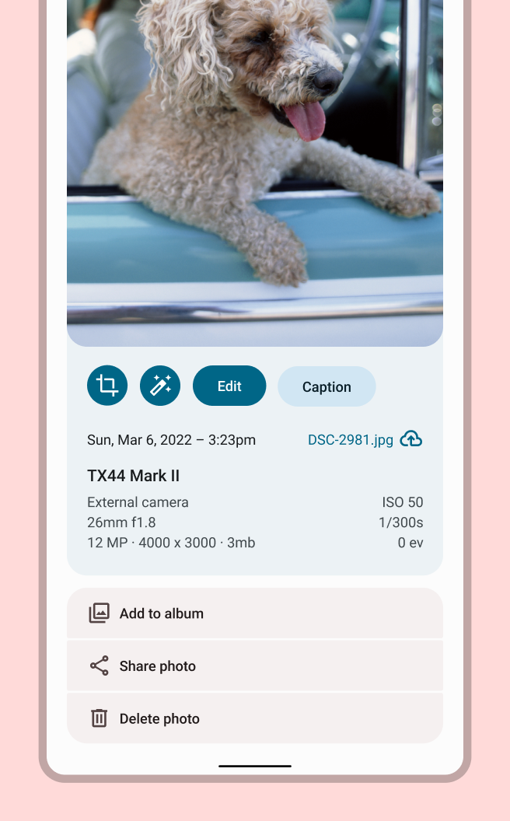
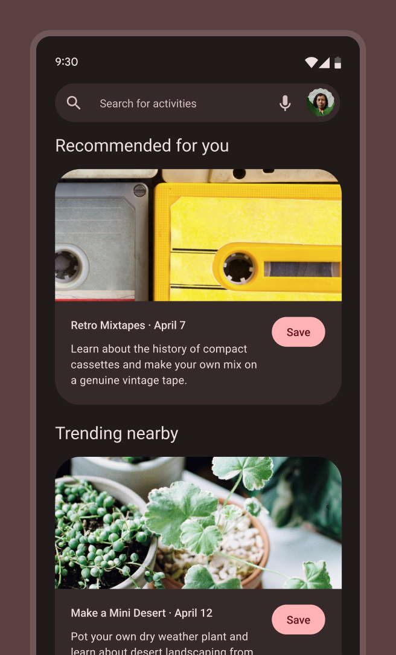
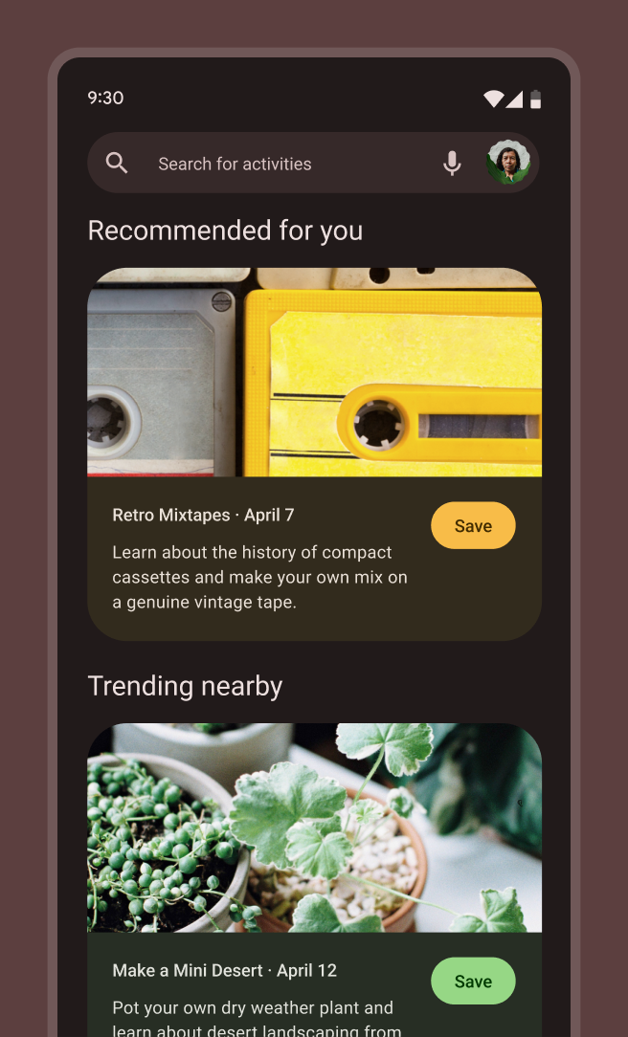

Slide 10
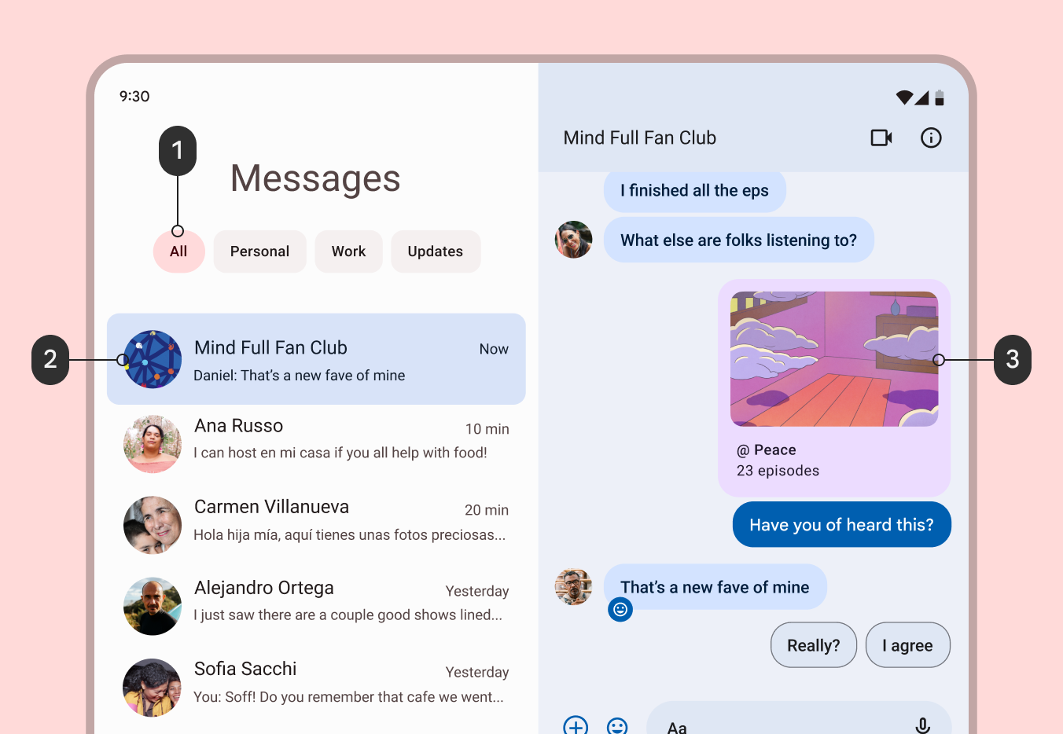

Slide 11
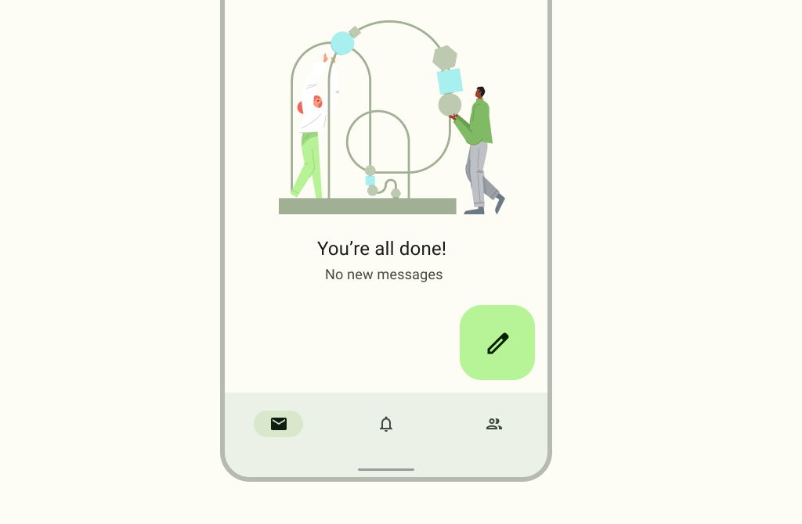
Illustration
SVGs are the most efficient format for illustrations to adapt to dynamic colors as it has flexibility of control in applying the established color system to the different parts of a single illustration.

Slide 12
